Slide 1
Lecture 7 Application in Model Checking
(cont.)
Omega-regular languages
Buchi automata and their equivalence
Model-checking omega-regular properties

Slide 2




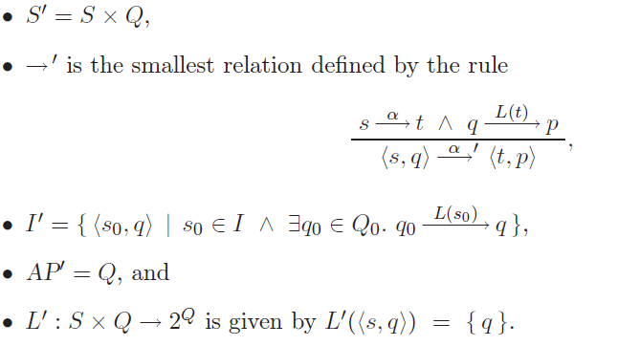
Product of Transition system and NFA
Let be a transition system without terminal states and an NFA with the alphabet

Slide 3
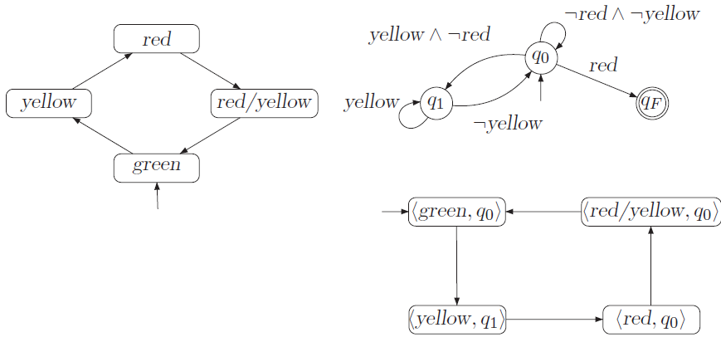
A product TS for German traffic light
AP={red, yellow},
L(green)=L(red/yellow)=0

Slide 4
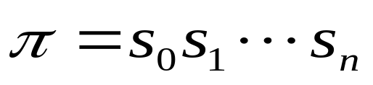
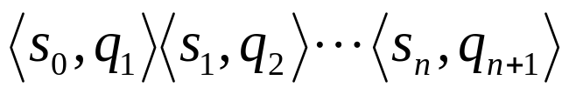


What is the role of NFA in the product
A sequence fragment in TS can be extended to a path fragment
in for which
is a computation of NFA that generates the word

Slide 5
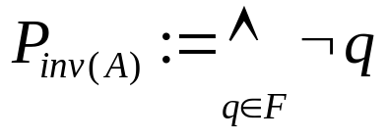
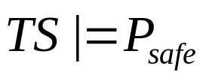
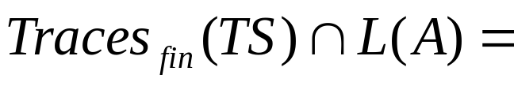
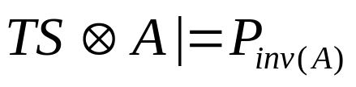
Reducing verification of regular safety property (to what)
Recall that AP’ =Q. Define
L(A)=MinBadPref(Psafe). The following statements are equivalent:
;
0;
.

Slide 6
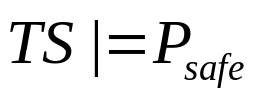


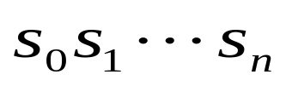

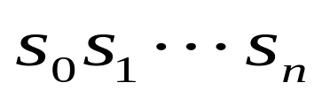
Model checking regular safety properties
In order to check whether , it suffices to check whether
Reachability analysis: Implement the invariant checking of Pinv(A) in .
If the Psafe is refuted, then the algorithm produces a finite path fragment in
where . Correspondingly, we have an initial finite path fragment in TS
such that is accepted by A. So we obtain a counterexample:
(From the above theorem)

Slide 7
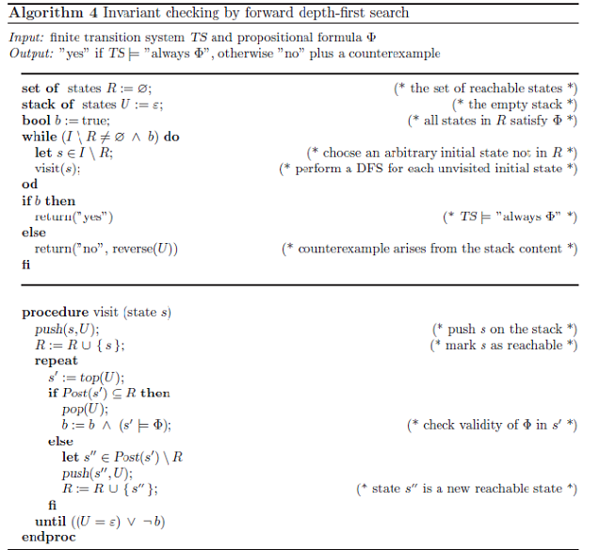

Slide 8
Example: the German traffic light
The verified safety property is: a red light phase
Should be immediately preceded by a yellow one.
What if the start state of TS is red instead?

Slide 9
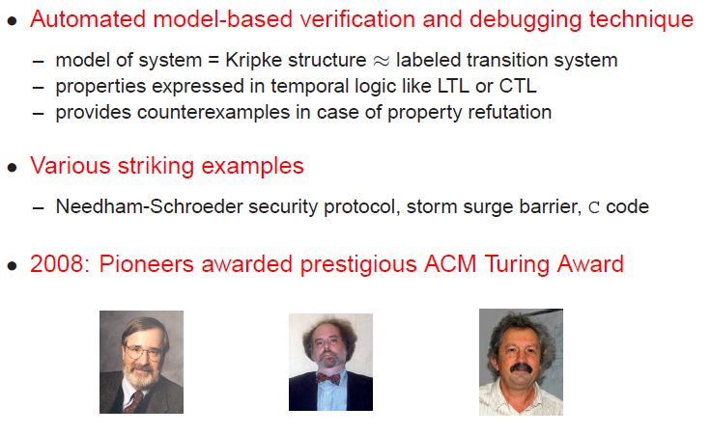
Model checking

Slide 10
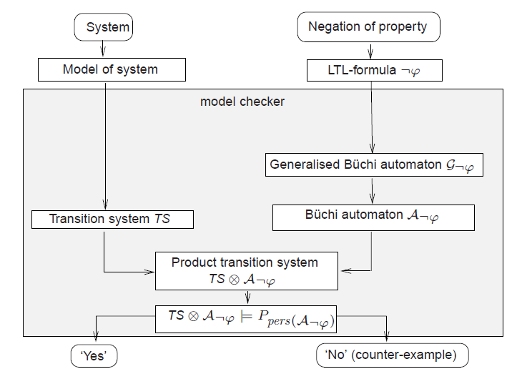
Overview of Model-Checking
Last course
Regular safety property
MinBadPrefix
NFA
Pinv
DFS Invariant-checking

Slide 11
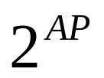
Outline of today’s lecture
The whole scheme is in parallel to that for regular safety properties
where P is an omega-regular property and A is an automaton for all “bad” traces.
Note that the alphabet set for model checking is the set of atomic propositions

Slide 12




Some conventions
Any subset of is called a language of infinite words, also called an -language
A language will be used for any subset of and is denoted as L
for infinite word and
u, v, w for finite words

Slide 13
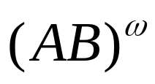
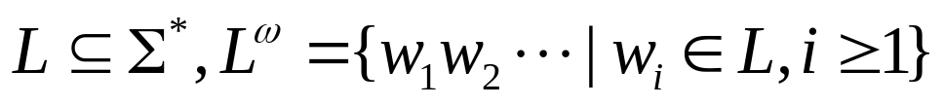
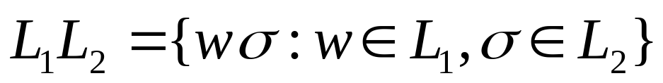
Infinite (omega) repetition
For a finite word AB,
For a language
Concatenation of a language L1 of finite words and a language L2 of infinite words

Slide 14

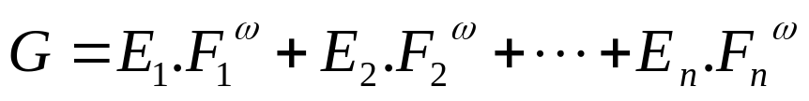

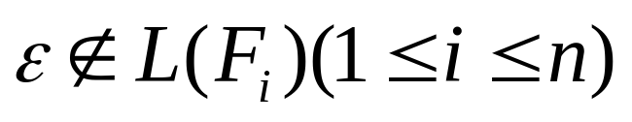

Omega-regular expressions
An omega-regular expression G over the alphabet is of the form
Where and E1,E2,…,F1,F2…. are regular expressions over such that
For the above expression G,
which is called an omega-regular language.

Slide 15
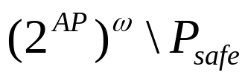
Omega-regular properties
An omega-regular property over the alphabet is a omega-regular language over
Both invariants and regular safety properties are omega regular properties
Examples:
Pinv

Slide 16
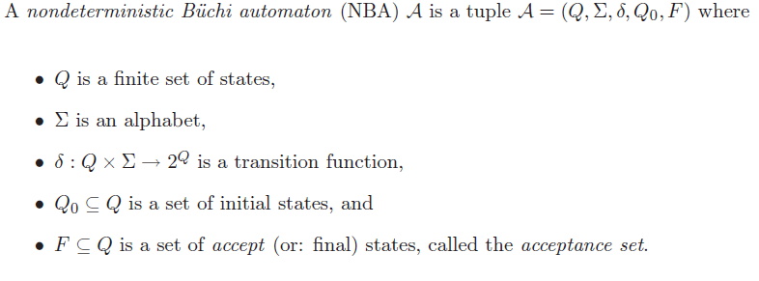

Nondeterministic Buchi automaton (NBA)
It is the same as the
definition of NFA AGAIN!
A is called nonblocking if for all symbols A and all states q

Slide 17
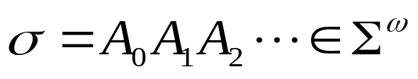
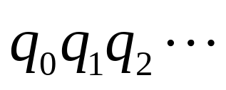

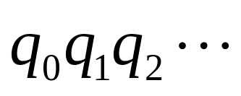
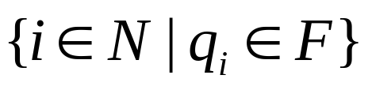

Computation and Acceptance
A run (computation) for an infinite
word is an infinite sequence of states in A such that . The run is accepting if
is infinite
Lw(A)={ : there is an accepting run for }
1 What is the essential difference of this acceptance condition
from those for NFAs and
2.Why do we need infinity?
3.Can you define new “automata” accepting infinite words?
acceptance by final states

Slide 18
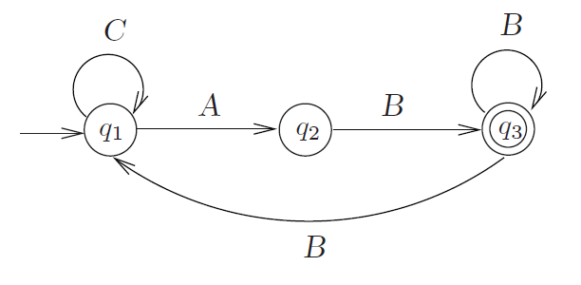
Example: NBA
Design an NBA recognizing the property of
“infinitely often green”

Slide 19
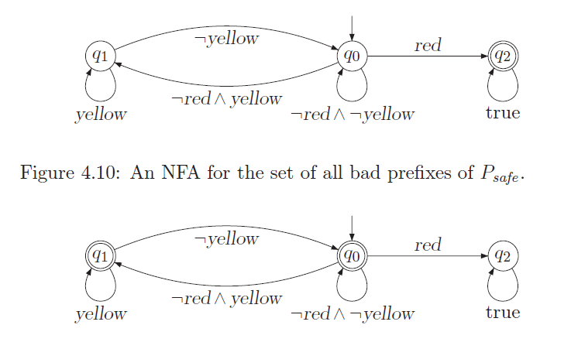
Example:
Any regular safety property can be represented by an NBA!

Slide 20
Every omega-regular language is recognized by an NBA (how to show)
1
Union operator on NBAs
0
start
A
1
B
0
start
C
0
D
0
0
1
1
E
1

Slide 21
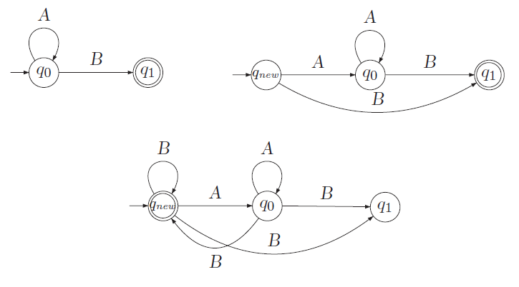
Omega-Operator for NFAs

Slide 22
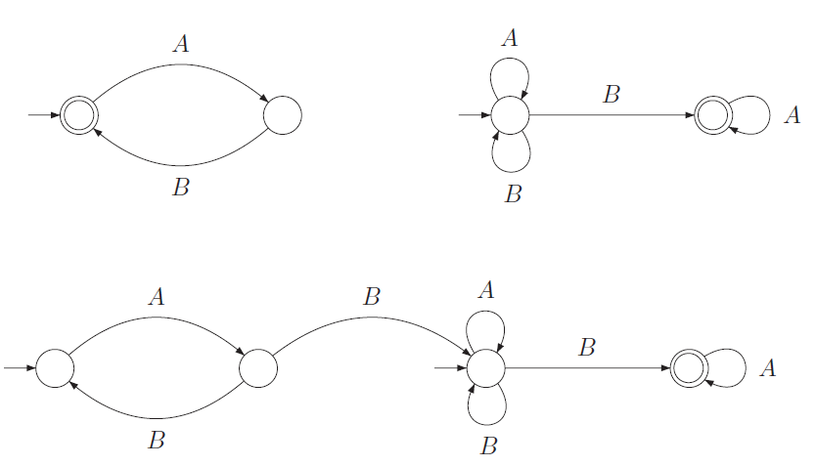
Concatenation of an NFA and an NBA

Slide 23
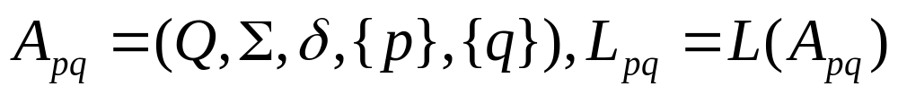
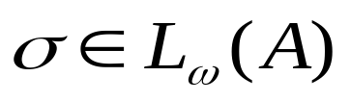


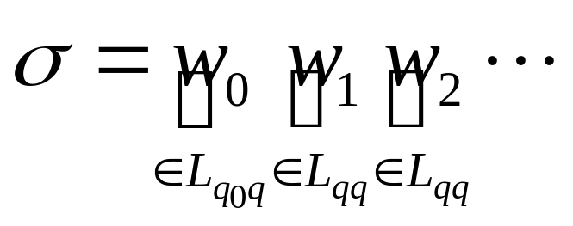
Every language accepted by an NBA is omega regular.
Proof idea: For any two states p and q, define
Now consider a word and an accepting run for in A where q is an accepting state:
NBA vs NFA

Slide 24
Closure properties of omega-regular languages
The class of omega-regular languages is closed under union, intersection, and complementation.

Slide 25
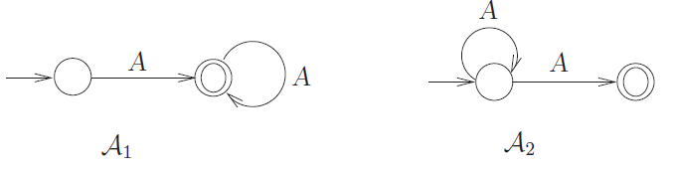
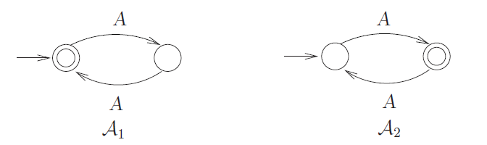
NFA vs. NBA equivalence

Slide 26
NBA equivalence and NFA equivalence
If A1 and A2 accept the same finite words, then this does not mean that they also accept the same infinite words.
If A1 and A2 accept the same infinite words, then this does not mean that they also accept the same finite words.
However, if A1 and A2 are both deterministic, then L(A1)=L(A2) implies Lw(A1) = Lw(A2).

Slide 27
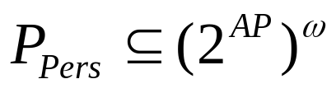

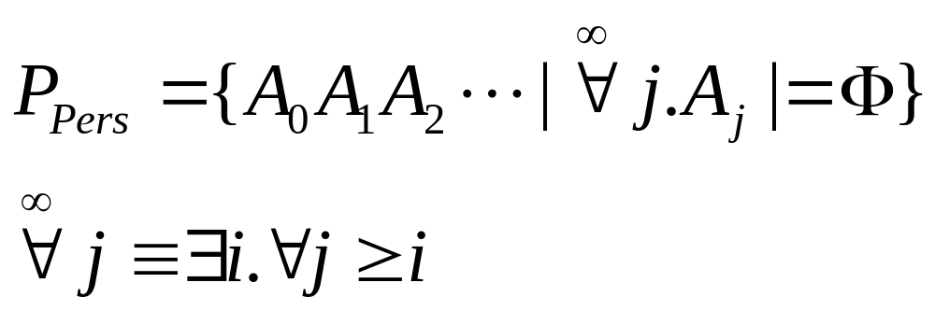
Persistence property: an extension of invariants
A persistence property over AP is an LT property “eventually forever ” for some propositional logic formula over AP:
where
In mathematics, it means “sufficiently large”.

Slide 28
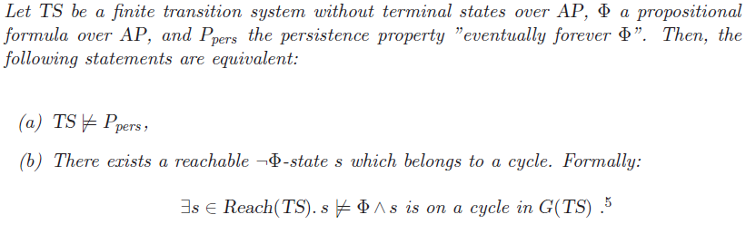
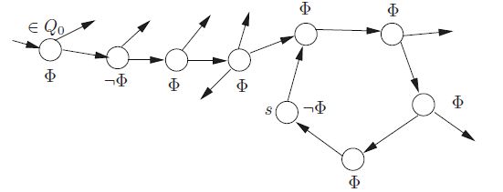
Persistence checking

Slide 29
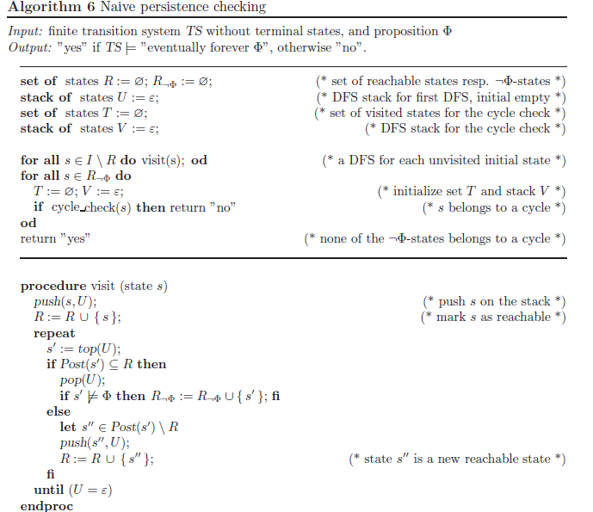

Slide 30
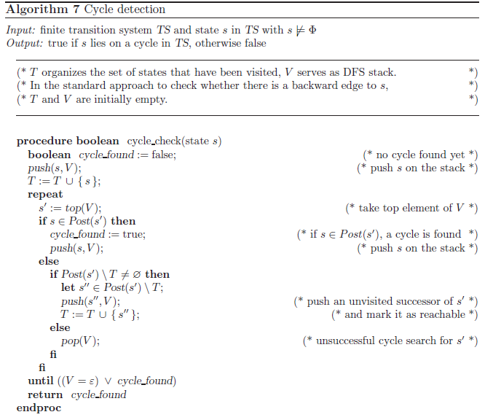

Slide 31
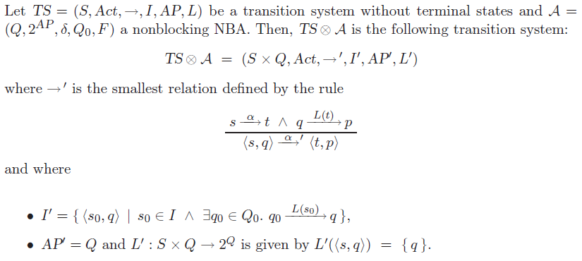
Product of TS and NBA (undesired property )

Slide 32
What is the role of NBA in the product
A sequence fragment in TS can be extended to a path fragment
in for which
is a computation of NBA that generates the word

Slide 33
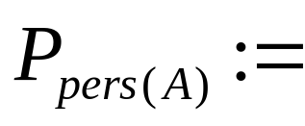
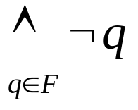
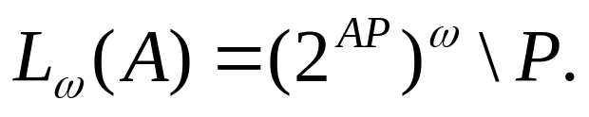

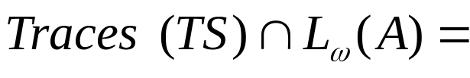
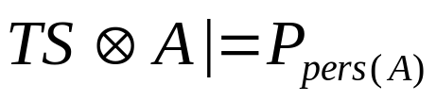
Reducing verification of omega-regular property (to what)
Recall that AP’ =Q. Define
“eventually forever”
The following statements are equivalent:
;
0;
.
Persistence checking
Please read Algorithm 8
in the Textbook.

Slide 34
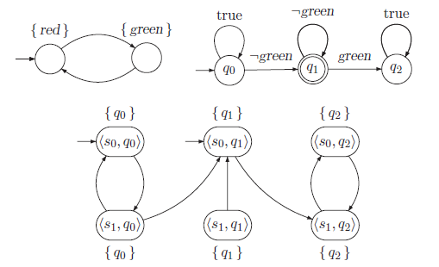
Example: “infinitely often green”

